Slide 1
Magnetism
Success Criteria
I can draw and describe magnetic fields.
I can calculate magnetic field strength.

Slide 2
Magnetic fields
Content Development
Magnetism is a non-contact force
Every permanent magnet is a dipole (has a north end and a south end)
If you break a magnet in two, each piece will still be a dipole
N
S
N
S
N
S

Slide 3
Magnetic fields
Content Development
Drawing magnetic fields: Lines show what a north end magnet would do
Magnetic field lines start in the North and move to the South
The field lines can never touch
N
S
N
S
N
S
N
S

Slide 4
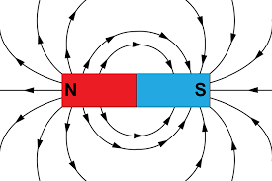
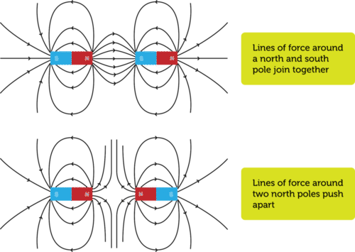
Magnetic fields
Content Development
Drawing magnetic field: Lines show what a north end magnet would do
Magnetic field lines start in the North and move to the South
The field lines can never touch
N
S

Slide 5
Magnetic fields
Content Development
Drawing magnetic field: Lines show what a north end magnet would do
Magnetic field lines start in the North and move to the South
The field lines can never touch
N
S
S
N
N
S

Slide 6
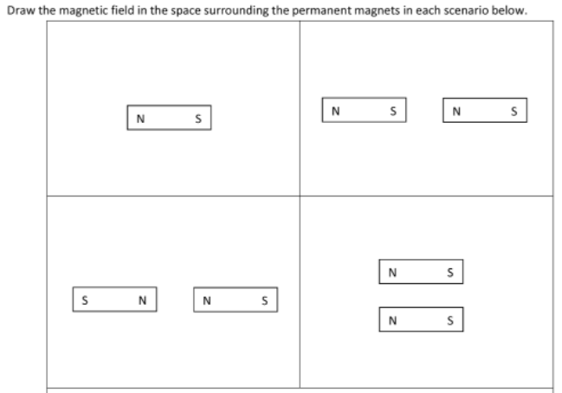
Magnetic fields
Content Development
N
S

Slide 7
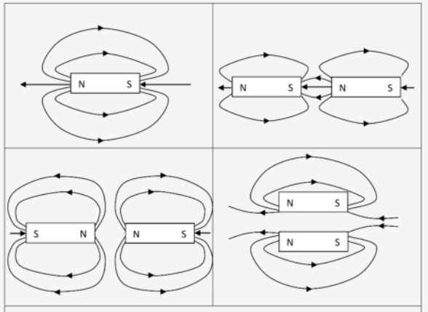
Magnetic fields
Content Development
N
S

Slide 8
Magnetic fields
Content Development
Magnetic fields are created by moving charges.
In the 1800s, Hans Christian Ørsted discovered that compass near a current-carrying conductor (a wire in a circuit) was deflected (the needle moved).
There is a very strong link between electricity and magnetism and this course will explore that connection.
Notes:
General magnetism
https://www.youtube.com/watch?v=IgtIdttfGVw&ab_channel=ProfessorDaveExplains
Electricity producing an magnetic field
https://www.youtube.com/watch?v=s94suB5uLWw&ab_channel=CrashCourse

Slide 9
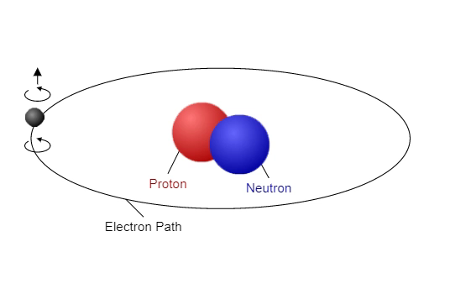
Magnetic fields
Content Development
Magnetic fields are created by moving charges.
If we consider the atomic model, electron are charged particles in motion. As electrons move, they create tiny magnetic fields.
Normally, the electrons are moving in random directions and these tiny magnetic fields cancel each other out. But if you can align or move the electrons in the same direction, you can create detectable magnetic fields.
Note: the reality is far more complicated (it is related to the ‘spin’ of an electron which we touch on in Semester 2) but this is sufficient detail for the current topic. One of the fundamental properties of an electron is that it has an magnetic dipole moment. A moving charge will create a magnetic field.

Slide 10
Atomic magnets
North
South
Electrons circling in atoms make the atoms behave like tiny magnets: This effect is very strong in iron
E J Vine.
Notes:
Iron is the element which produces the strongest magnetic fields
If you could see these tiny atomic magnets you would see that they form magnetic groups called domains.
The domains can be lined up inside an iron or steel bar.
All you need is a magnetic field to line them up.

Slide 11
An iron or steel bar which has not been magnetised.
S
N
S
N
No magnetic force field
Atomic Magnets all jumbled pointing at each other: Their fields cancel each other and this iron or steel bar would not be magnetic
E J Vine.
Notes:
The atomic magnets point at each other N to S and S to N. When they are like this then the magnetic fields effectively cancel and the bar has no external magnetic field.

Slide 12
Unmagentised steel or iron bar
N
S
E J Vine.
Notes:
The field from the red permanent magnets will gradually line up the magnetic domains.

Slide 13
The magnetic force field from the permanent magnets line up the atomic magnets and will make the steel or iron bar magnetic.
N
S
E J Vine.
Notes:
The field from the red permanent magnets gradually line up the magnetic domains.

Slide 14
The magnetic force field from the permanent magnets lines up the atomic magnets and will make the steel or iron bar magnetic.
N
S
E J Vine.
Notes:
The field from the red permanent magnets gradually line up the magnetic domains.

Slide 15
The magnetic force field from the permanent magnets lines up the atomic magnets and will make the steel or iron bar magnetic.
N
S
E J Vine.
Notes:
The field from the red permanent magnets gradually line up the magnetic domains.

Slide 16
The magnetic force field from the permanent magnets lines up the atomic magnets and will make the steel or iron bar magnetic.
N
S
E J Vine.
Notes:
The field from the red permanent magnets gradually line up the magnetic domains.

Slide 17
The magnetic force field from the permanent magnets lines up the atomic magnets and will make the steel or iron bar magnetic.
N
S
S
N
E J Vine.
Notes:
The blue bar now produces its own magnetic field.

Slide 18
The blue magnet now has its own magnetic field
S
N
E J Vine.
Notes:
The field from the red permanent magnets has lined up the domains and the blue bar has now become magnetic.

Slide 19
Magnetic fields
Content Development
Slides about ferromagnets
Notes:
General magnetism
https://www.youtube.com/watch?v=IgtIdttfGVw&ab_channel=ProfessorDaveExplains
Electricity producing an magnetic field
https://www.youtube.com/watch?v=s94suB5uLWw&ab_channel=CrashCourse

Slide 20
Magnetic fields
Content Development
Slides about electrons in current-carrying conductor generating a magnetic field
Define term: current-carrying conductor
Stress conventional current vs electron flow
Discuss affect of different variables on magnetic field. Maybe via Orsted-style demonstration. Need circuit with exposed wire + magnets. Vary distance from wire and current.
Notes:
General magnetism
https://www.youtube.com/watch?v=IgtIdttfGVw&ab_channel=ProfessorDaveExplains
Electricity producing an magnetic field
https://www.youtube.com/watch?v=s94suB5uLWw&ab_channel=CrashCourse

Slide 21
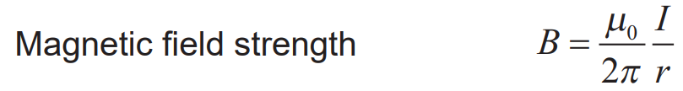
Magnetic Field Equations
Content Development
B is the magnetic flux density (T: Teslas) similar to E or g
μ_{o} is the magnetic permeability (4*π*10⁻⁷ NA⁻²)
I is the current (A)
r is the distance from wire (m)

Slide 22
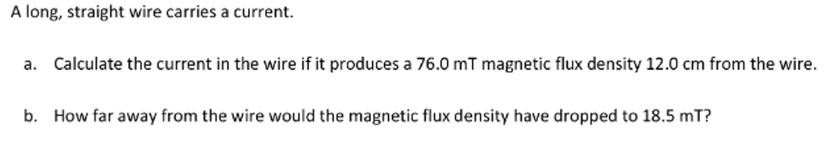
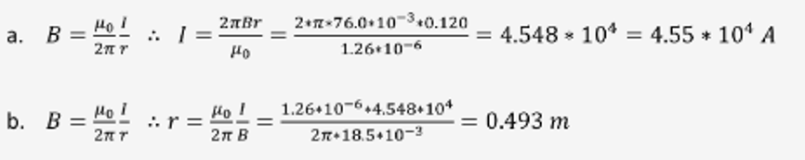
Magnetic Field Equations
Content Development

Slide 23

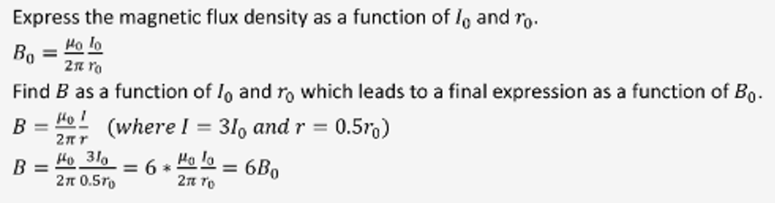
Magnetic Field Equations
Content Development

Slide 24
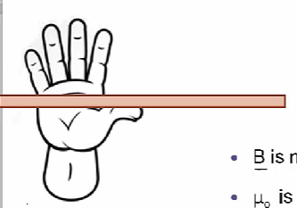
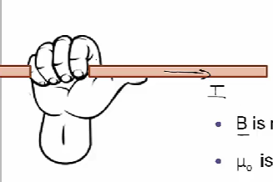
Magnetic Field Direction
Content Development
Right hand rule:
- Place your right hand against the wire
Point your thumb in the direction of the conventional current
Grab the wire
Your fingers now point in the direction of the magnetic field
Conventional current direction
Notes:
Field makes concentric circles around the wire
Note that this is 3D. It passes in front of the wire in the foreground and behind the wire in the background

Slide 25

Magnetic Field Symbols
Content Development
It gets very confusing trying to draw magnetic fields on wires as they need to be 3D. Instead of lines, if a field line is going into or out of the page, we use symbols.
.
.
coming out of the page
X
X
going into the page
or
or
Picture it like an arrow:
If the arrow is coming towards you, you just see the point.
If the arrow is going away from you, you just see the fletching.
.
.
X
X
Notes:
Circles not required

Slide 26
Magnetic Field Symbols
Content Development
It gets very confusing trying to draw magnetic fields on wires as they need to be 3D. Instead of lines, if a field line is going into or out of the page, we use symbols.
.
.
coming out of the page
X
X
going into the page
or
or
.
.
.
.
.
.
.
.
.
.
.
.
.
.
.
x
x
x
x
x
x
x
x
x
x
x
x
x
x
x
Notes:
Note that the lines are getting further apart. This is to show that the field weakens as the distance from the wire increases.

Slide 27
Magnetic Field Direction
Content Development
Notes:
Field makes concentric circles around the wire
Note that this is 3D. It passes in front of the wire in the foreground and behind the wire in the background

Slide 28
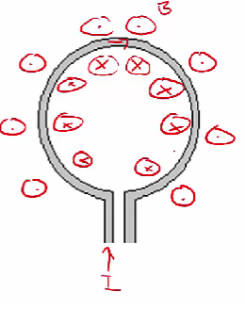
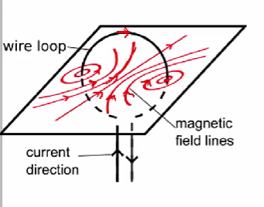
Magnetic Field Direction
Content Development

Slide 29
Homework

